Slide 1
The Anatomy of YouTube Success
A Global Analysis of the World’s Biggest Video Platform
Yakkala Viswanadha Kartikeya
Exploratory Data Analysis Project
July 22, 2025

Slide 2
The Big Picture: Why YouTube?
YouTube isn’t just a video site; it is a global cultural and economic phenomenon.
It has created careers, launched brands, and changed the way we consume media.
In this analysis, we dive into the data behind the platform’s most successful channels to understand the key drivers of growth, earnings, and popularity.
Our Goal: To uncover the patterns and correlations that define success on a global scale.

Slide 3
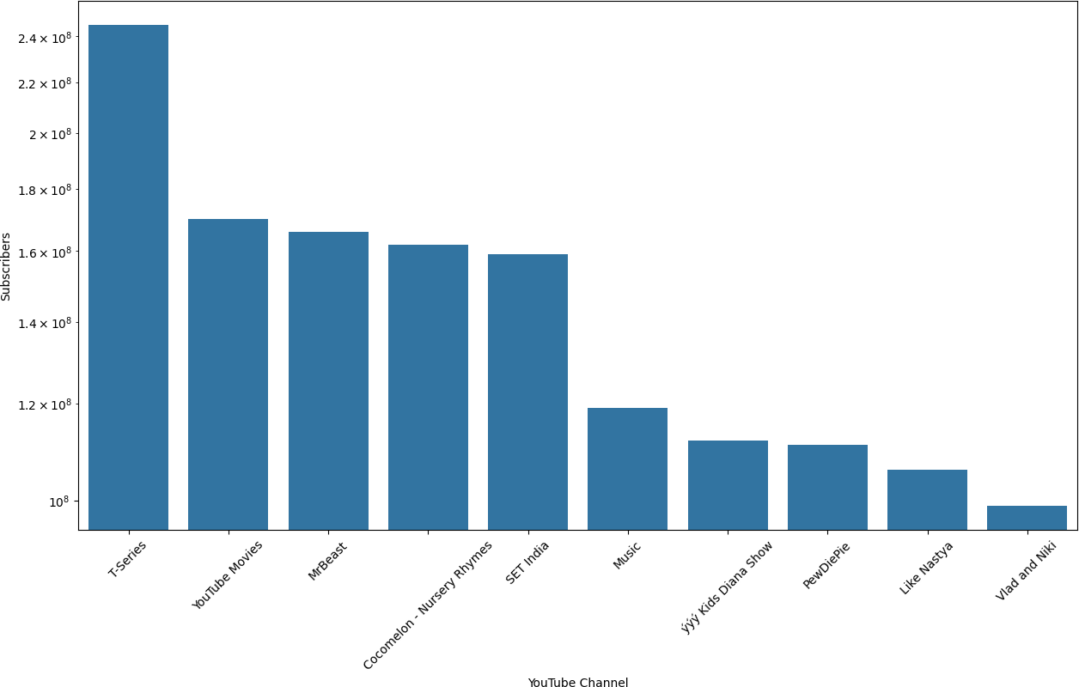
The Titans of YouTube
The top of the YouTube mountain is occupied by a mix of major media corporations and native digital creators.
Dominant forces include:
Music: (T-Series, Music)
Children’s Content: (Cocomelon, Kids Diana Show)
High-production Entertainment: (MrBeast)

Slide 4
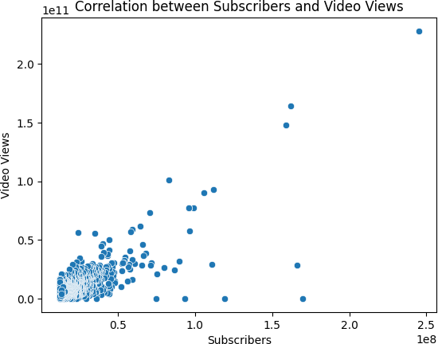
What’s the Magic Formula? Subscribers + Views
We found a moderate positive correlation (0.75) between a channel’s subscriber count and its total video views.
What this means
A large subscriber base is a strong indicator of high view counts. It acts as a built-in audience for new content, creating a powerful feedback loop for growth.

Slide 5
The Global YouTube Hotspots
The United States is the undisputed leader, home to 440 of the top channels in our dataset.
India follows as a strong second with 169 channels, showcasing its massive and engaged audience.
Emerging digital economies like Brazil, the UK, and Mexico also feature prominently.

Slide 6
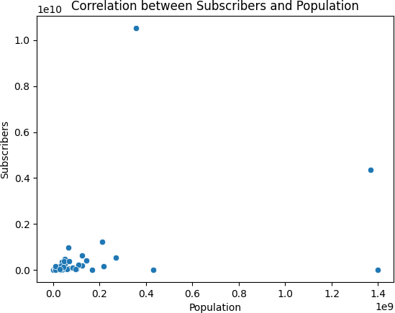
Does a Bigger Country Mean More Channels?
We found only a weak positive correlation (0.36) between a country’s population and its number of top YouTube channels.
Insight
While a large population provides a potential audience, other factors like internet infrastructure, economic conditions, and cultural trends play a more significant role in fostering a successful creator ecosystem.

Slide 7
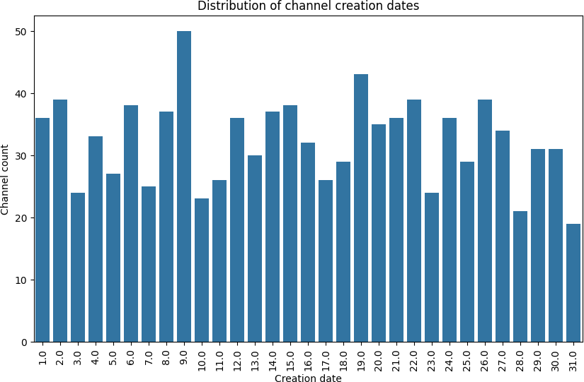
When Were the Top Channels Created?
Our analysis of channel creation dates shows a distribution across the days of the month.
There is a notable peak for channels created around the 9th day of the month. However, the distribution shows that successful channels are launched throughout the month.
Success is not about the specific day you launch, but about consistently producing quality content over time.
Key Takeaway

Slide 8
Does Unemployment Affect YouTube Growth?
We investigated the link between recent subscriber growth and national unemployment rates.
The result was a correlation value of 0.18, which indicates no meaningful correlation.
Insight
Short-term channel growth does not appear to be directly influenced by a country’s unemployment rate. This suggests that viewers’ content consumption habits and creators’ motivations are driven by factors other than immediate economic conditions.

Slide 9
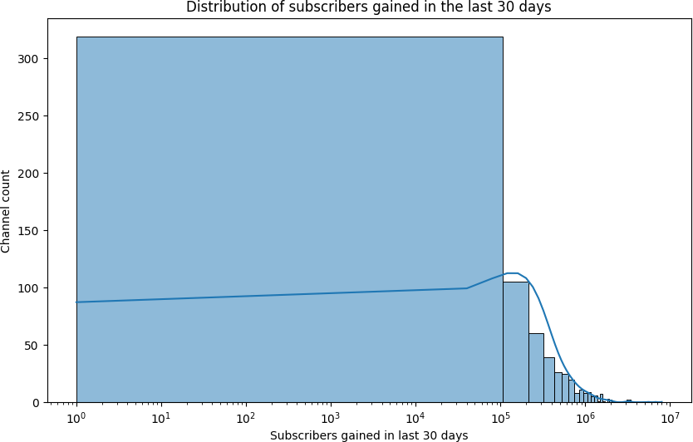
Recent Subscriber Growth Trends (Last 30 Days)
The trend for subscribers gained in the last 30 days is heavily
right-skewed, indicating that most channels see modest growth while a few experience explosive, outlier growth.
Mean: 350,000 subscribers
Median: 200,000 subscribers
Mode: 100,000 subscribers
The median is a better representation of typical channel growth than the mean, which is inflated by a few hyper-successful channels.
Insight

Slide 10
Recent Viewership Trends (Last 30 Days)
When analyzing video views over the last 30 days, we see significant variation across different channel types.
High Performers: Music and Entertainment channels consistently show a very high median number of views.
Wide Variation: The ”Autos” channel type shows an extremely wide range of viewership, with some channels performing exceptionally well and others very poorly.
Stable Performers: Categories like Education and Howto show a more compressed and stable range of viewership.

Slide 11
The Most Popular (and Profitable) Content
Highest Engagement: The ”Shows” category boasts the highest average subscriber count.
Highest Volume: ”News & Politics” and ”Entertainment” channels upload content far more frequently.
Highest Earnings: Entertainment channels show the highest potential earnings, with some reaching up to $13.6 million per month.

Slide 12
A Deeper Dive: Category vs. Channel Type
Broad categories are not monolithic. A single category like ”Entertainment” contains many different, more specific channel types.
Diverse Categories: ”Entertainment” is the most diverse, acting as a catch-all for Music, Games, People, and more.
Specialized Categories: In contrast, categories like ”Music” and ”Gaming” are highly specialized, primarily containing channels of their own type.
This highlights the structure of YouTube’s ecosystem. While some categories are very specific, ”Entertainment” serves as a broad hub for a wide variety of content creators.
Insight

Slide 13
The Outliers: YouTube’s 1%
Our analysis of yearly earnings reveals a stark reality: a small number of channels earn exponentially more than the rest.
The boxplots for earnings show a large number of outliers, indicating a
”winner-take-all” market.
The vast majority of channels earn modestly, while a select few achieve massive financial success.

Slide 14
The Blueprint for YouTube Success
Content is King, but Category Matters: Entertainment, Music, and Children’s content are proven paths to massive audiences.
Audience is Everything: Building a loyal subscriber base is the most reliable way to guarantee long-term views and growth.
Geography is a Major Factor: The US and India are the current epicenters of YouTube creation, but other nations are quickly catching up.
Success is an Outlier: While the opportunity is there for everyone, massive financial success is rare and concentrated at the very top.

Slide 15
Thank you

